Slide 1
Atlantic Language
Introduction to CLIL
What is CLIL and how do CLIL teachers design their lesson?
How does a CLIL lesson differ from a language lesson or a subject lesson?
What are the key concepts in CLIL and are they useful for me and my classes?

Slide 2
What is CLIL?
Research & work together to come up with a definition:
Create a definition: CLIL is……………..

Slide 3
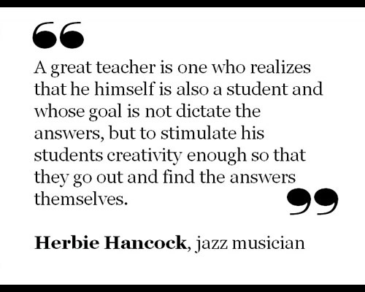
The acronym itself is a good one, because it is largely self-explanatory. Invented back in the mid-1990's, it seems to be passing the test of time. CLIL itself has been around for a long time - and was put into practice by ancient Roman upper-middle classes, who preferred to have their children educated in Greek.
Phil Ball Article: What is CLIL? | Article | Onestopenglish
"CLIL is about using languages to learn………..It is about installing a 'hunger to learn' in the student. It gives opportunity for him/her to think about and develop how s/he communicates in general, even in the first language".
(Marsh, Marsland & Stenberg, 2001)

Slide 4
Content Driven & Communication
Teacher creates opportunities for the Application of Knowledge and development of Communication Skills

Slide 5
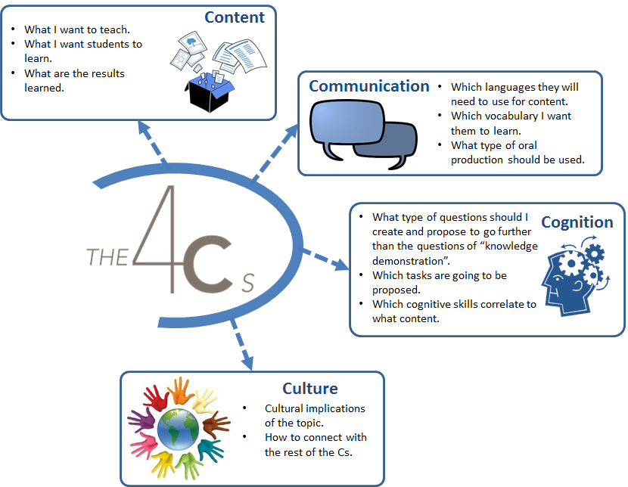

Slide 6
Further Research – The 4 C’s in CLIL
CLIL: Content – YouTube
CLIL: Communication – YouTube
CLIL: Cognitive – YouTube
CLIL: Culture - YouTube

Slide 7
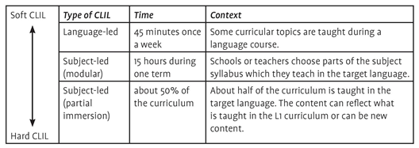
What is Hard and Soft CLIL?

Slide 8
Language Teachers Subject Teachers
Start to think more about the concepts and Start to think more about the language and how
how to teach these more effectively. To break down concept to help their learners
understand content in L2.
Amanda McLoughlin - To CLIL or not to CLIL …and what’s the big deal about CLIL, anyway - YouTube

Slide 9
Key considerations concepts in CLIL
Amanda McLoughlin - To CLIL or not to CLIL …and what’s the big deal about CLIL, anyway - YouTube

Slide 10
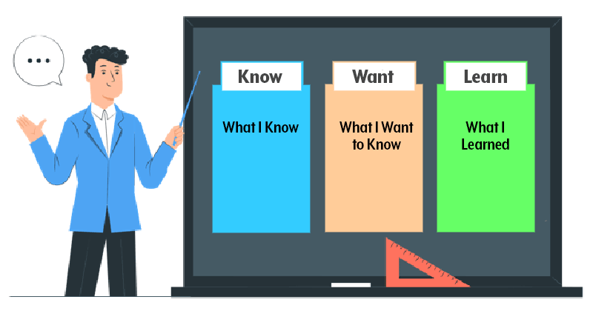
Activating Prior Knowledge

Slide 11
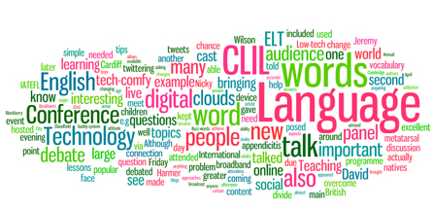
Activating Prior Knowledge
Finish the sentence
Word cloud
Quickest or Most
(10 verbs or Nouns)
Digital Tools
True or False

Slide 12
Activating Prior Knowledge
Ten Questions
Write the topic of the lesson on the board. Learners work in pairs and write down ten questions about the topic - at least four should begin with who, what, how and why.
Scrambled sentence
Nuclear environmentally is
the power most
energy. of
means friendly generating

Slide 13
Activating Prior Knowledge
The Placemat – or Padlet

Slide 14
Greater classroom interaction
Extended Initiation -Response-Feedback (I-R-F-I-R-F)
Longer student turns
Peer communication

Slide 15
Longer wait time
Wait time= time teachers wait between teacher asking question and student answering them
Longer wait time= allow sufficient time to allow thinking processes necessitated by the greater challenge posed, to occur- prior, during and after the activity

Slide 16
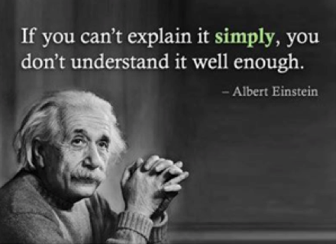
Modify input
Be careful with your choice of words
speak more slowly; insert more and longer pauses
stress certain words more than others

Slide 17
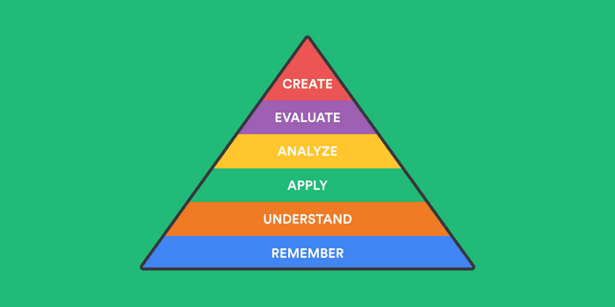
Cognitive Challenge
Teacher question types that require high-level cognitive responses from learners (HOTS and LOTS)
HOW? – IF? – SHOULD? – WHY? – WHAT IF…? – SUPPOSE or IMAGINE?
Long student turns to express higher level concepts

Slide 18
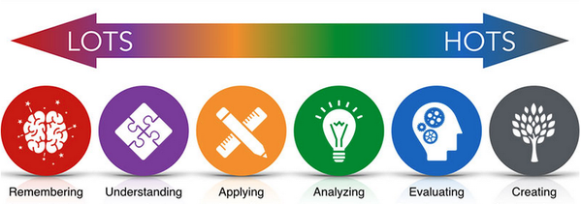
Cognitive Challenge
CLIL Thinking skills - LOTS and HOTS - YouTube

Slide 19
Three way combination
Concepts (Content)​
Procedures (Contextualized skills)​
Language (Using language to learn while learning language)​

Slide 20
reflection
How would you describe CLIL to a teacher who does not know what it is?​

