Slide 1
ATLANTIC
Digital Tools Workshop 2
Today’s Lesson:
Try out a lesson as a student using some popular teaching apps,
Learn how these apps can be adapted for our classes;
Create some materials for our students with new apps;
Share our experience, knowledge and tips!

Slide 2
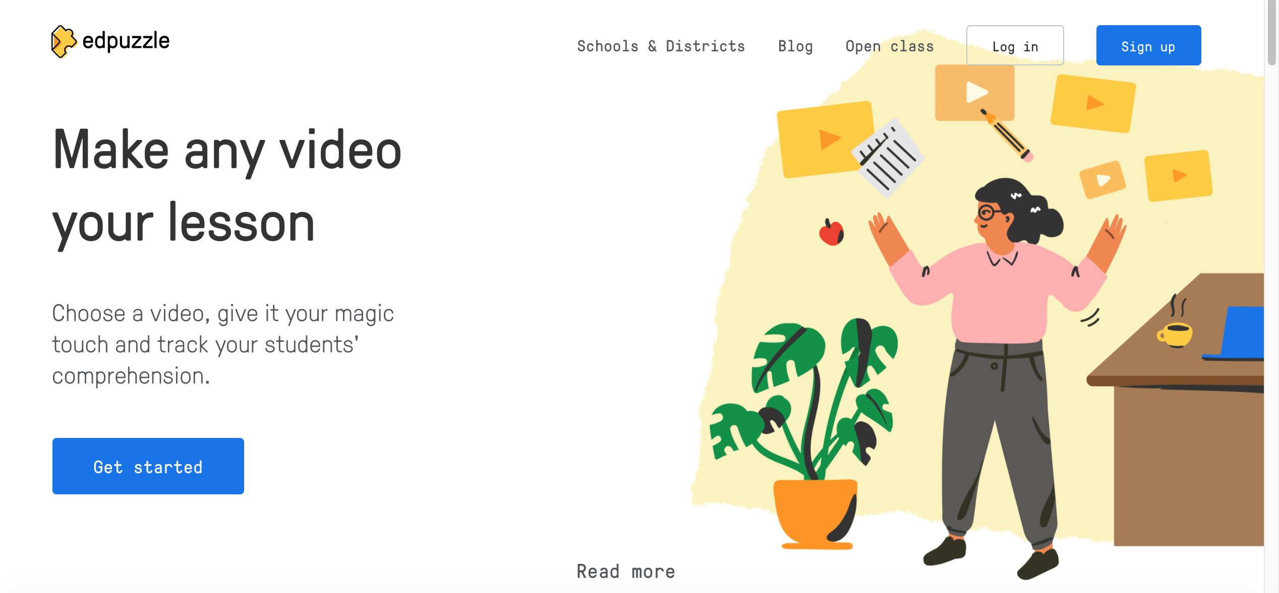
Would you like to do an Ed Puzzle lesson as a student Edpuzzle

Slide 3
Think of a subject and topic with new vocabulary or terminology that you would like your students to learn.
Create or find and edit an Edpuzzle lesson.
Present and share with other Teachers.
Edpuzzle

Slide 5
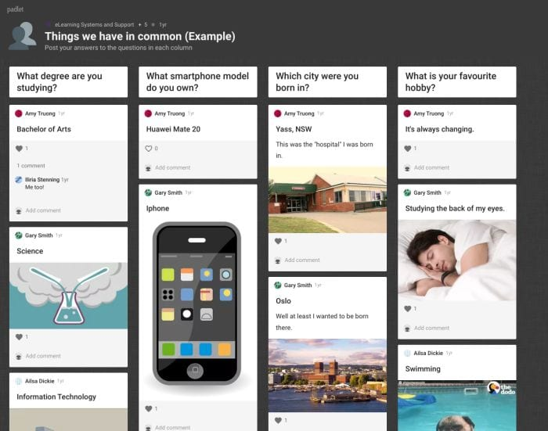

Slide 6
Think of a research/quiz or discussion topic that you would like your students to engage with.
Create a Padlet.
Present and share with other Teachers.
Sample: https://padlet.com/barborapejcharova1/isgogjbkl7eghl23

Slide 7
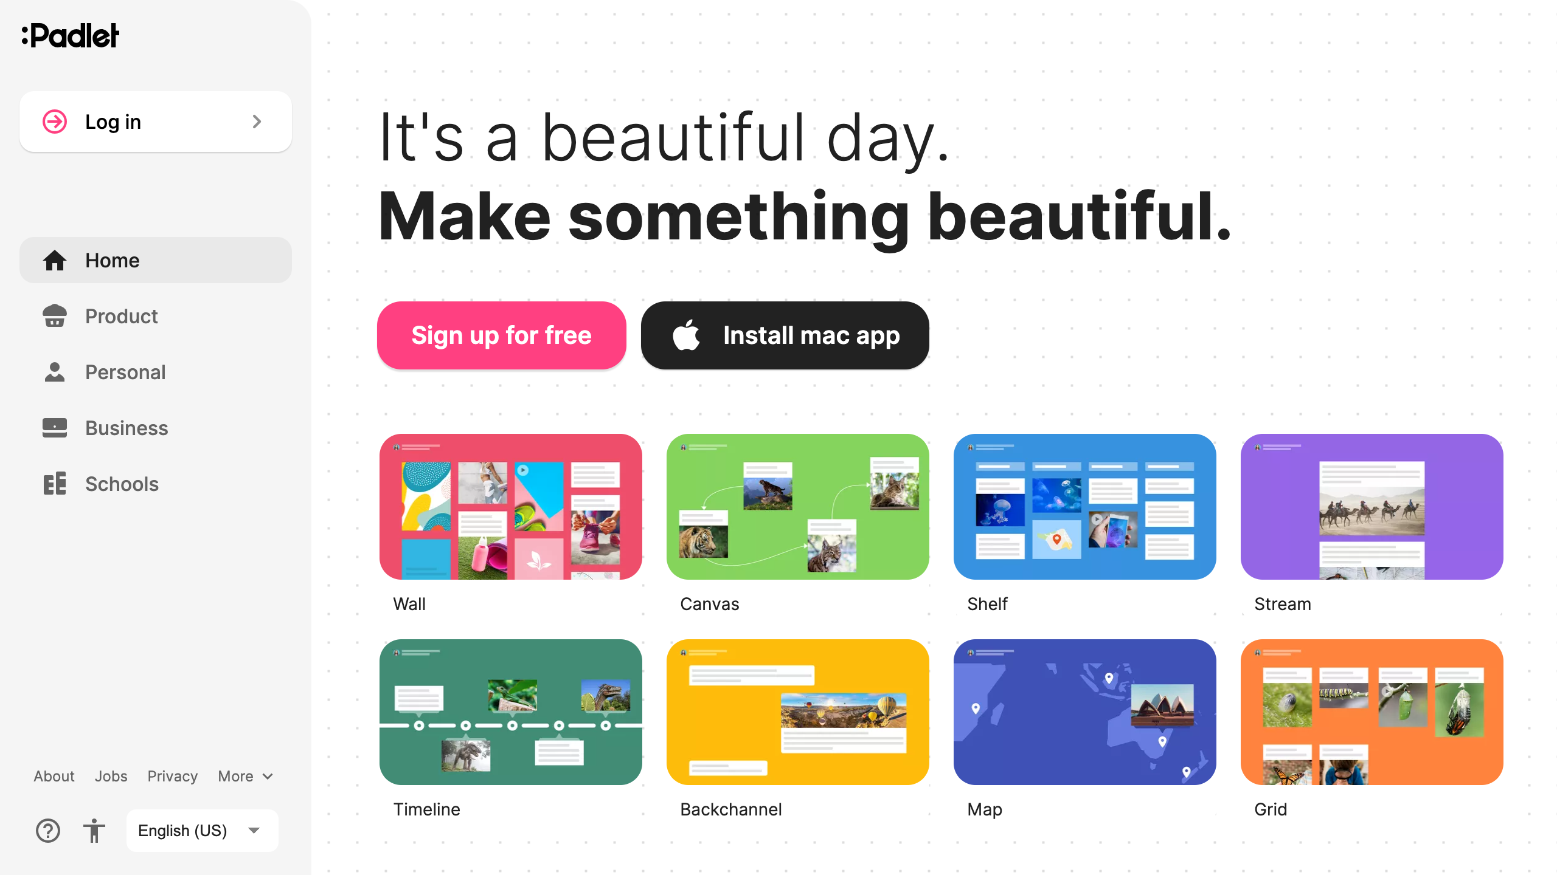
https://padlet.com/aoifetamura1/cpc3uv7ungt2jtac

Slide 8
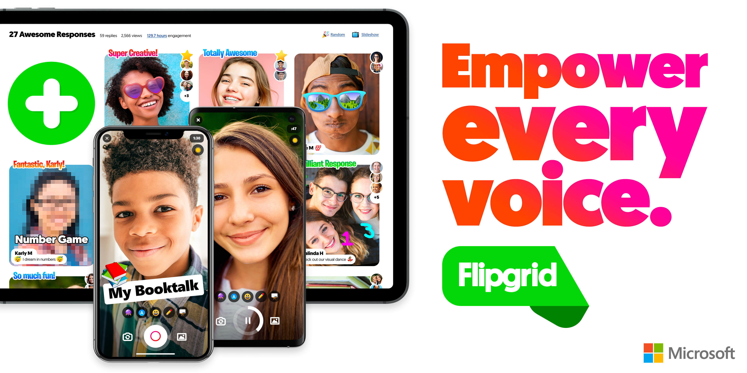

Slide 9
Create a class Flipgrid:
Getting Started — Flipgrid

