Slide 1
ATLANTIC COLLEGE
Digital Native or Digital Immigrant
Today’s Lesson:
Discuss the changes in our Teaching lives in the last year;
Review how our own relationship with technology has changed since we were students;
Reflect on how technology features in both our learning and teaching lives;
Evaluate how our students view materials which are Traditional and Digitally based.

Slide 2
How have you had to change and adapt the following over the last 2 years?
Materials used in class
Classroom Management
Teaching Style or Methodology

Slide 3
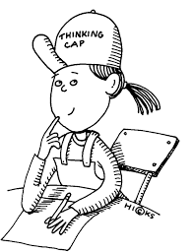
How has our own relationship with technology changed over our lifetimes?

Slide 4
What kind of learner are you? Do you like to have things explained to you? Do you rely on your mobile phone for information? Do you like multitasking? Do you have a short attention span? Do like to work on one task at a time? Do you read social media first thing in the morning? Do you get information from books? Do you like to read instructions before using technology for the first time?

Slide 5
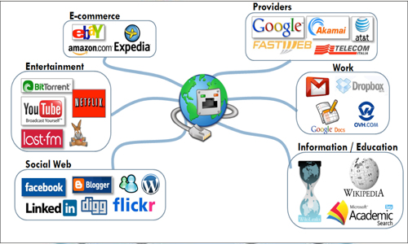

Slide 6
When you were a University student …
Did you like to have things explained to you?
Did you rely on your mobile phone for information?
Did you like multitasking?
Did you have a short attention span?
Did like to work on one task at a time?
Did you read social media first thing in the morning?
Did you get information from books?
Did you like to read instructions before using technology for the first time?

Slide 7
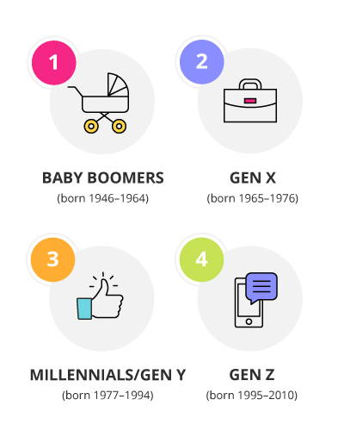
What is your generation (Baby Boomer/ Generation X or Y or Z)? How has this affected your teaching + learning style?

Slide 8
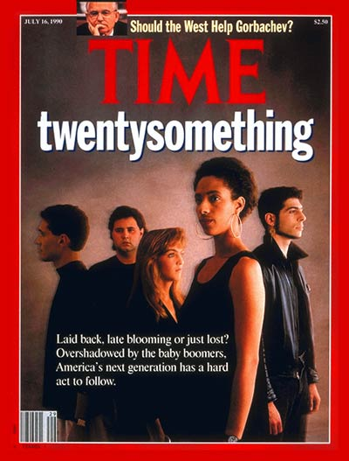
My Journey
What the world was like when I was a University Student.
1992-1998
We were called Generation X.

Slide 9
My learning was self-directed and the library was an inspiring place to be!

Slide 10
I studied Art and famous artists were my role models and they inspired me.

Slide 11
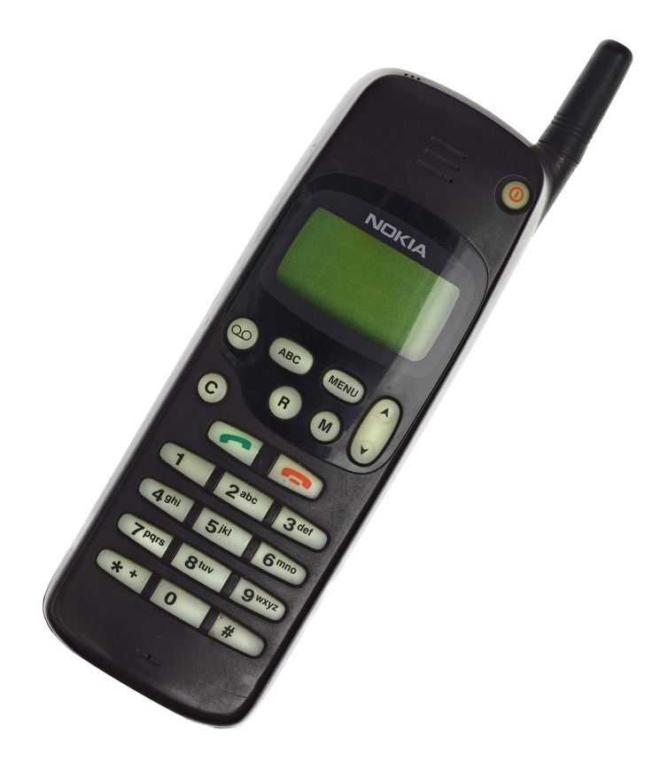
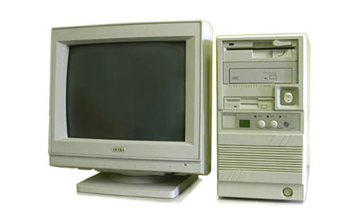
New technology didn’t really inspire me…….

Slide 12
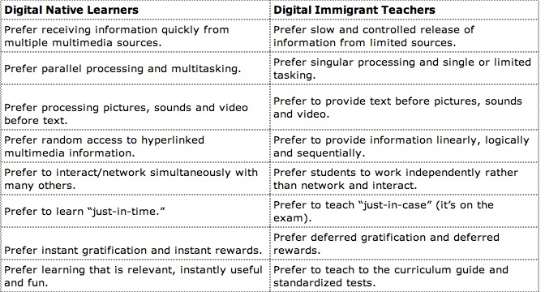
Jukes & Dosaj's (2003) chart outlines the key differences between digital native learners and their digital immigrant teachers.

Slide 13
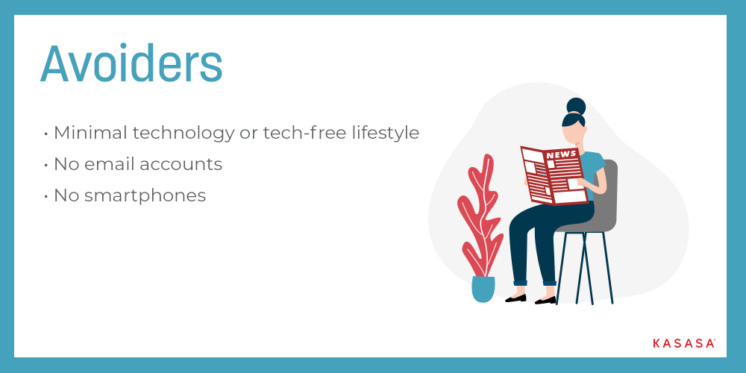
What kind of Digital Immigrant are you?

Slide 16
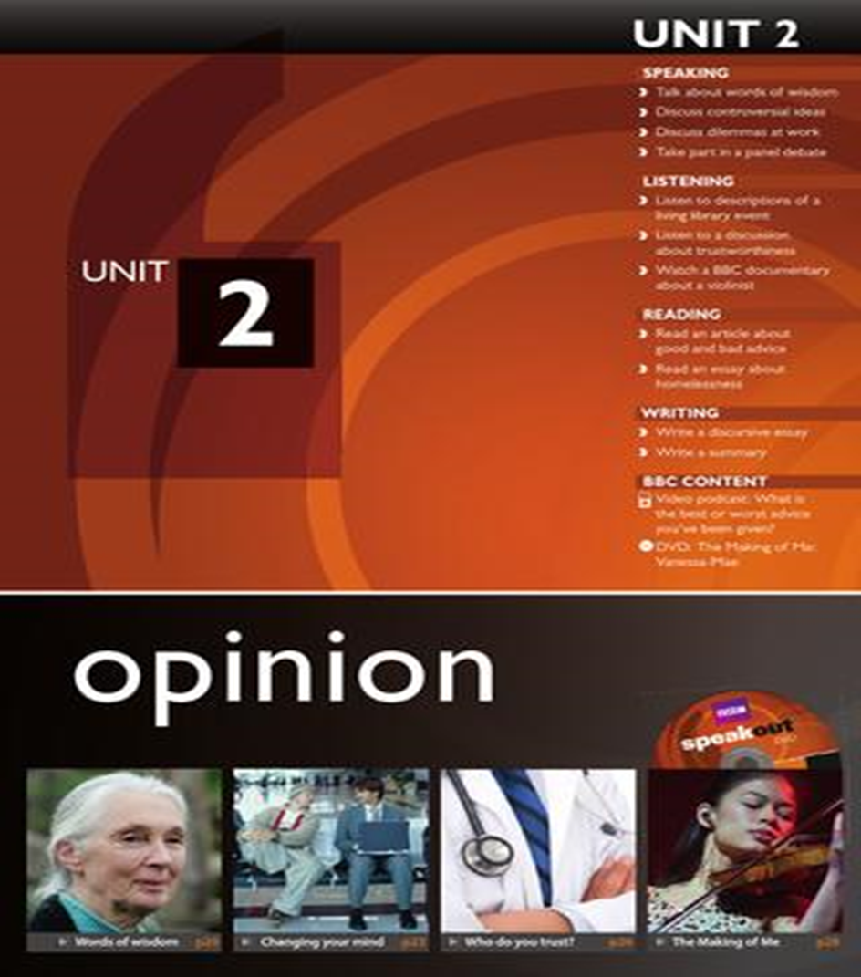
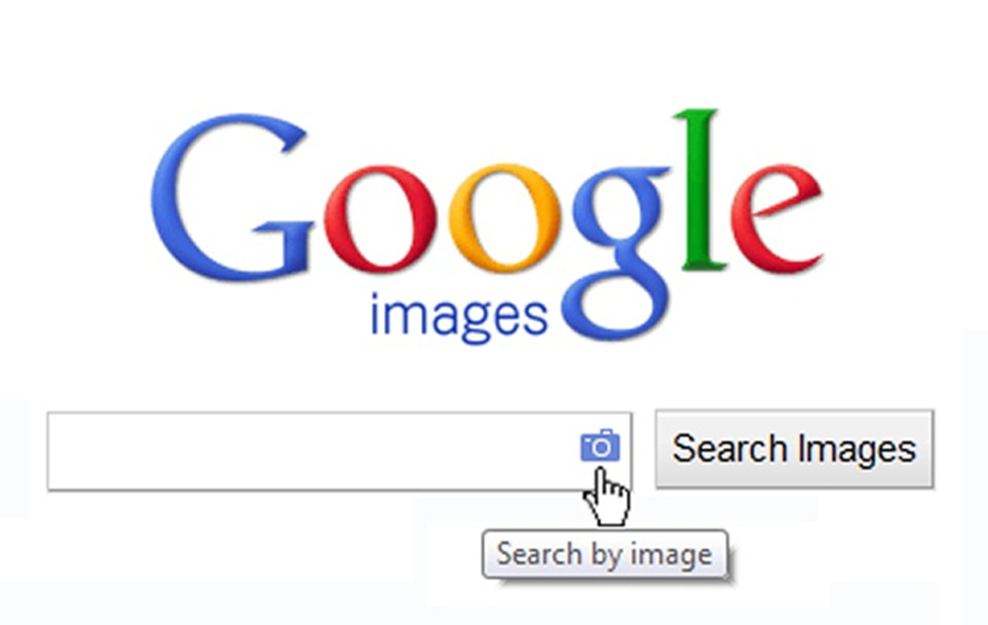
Let’s go to Page 83 to check
Teacher that book is very old (2018) I will check for you…

Slide 17
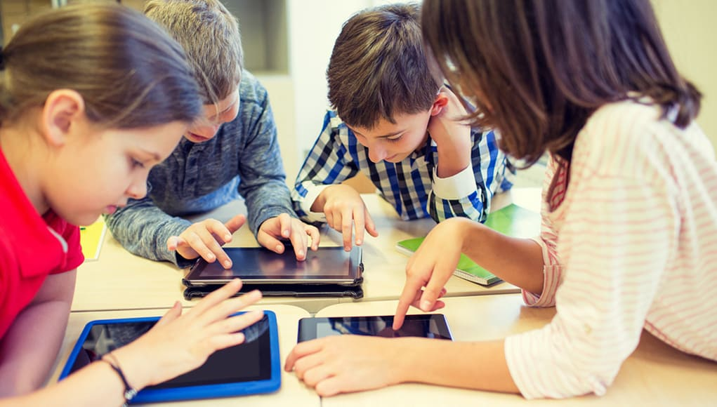
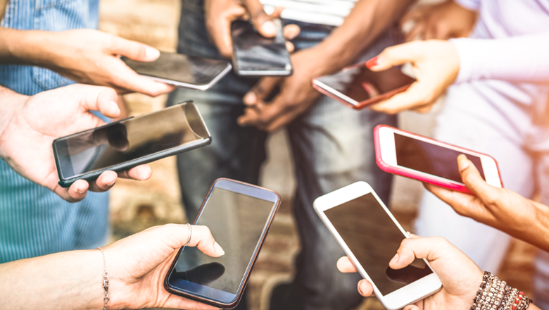
“Nowadays the temptations of instant gratification which sit in student’s pockets are so readily available, that the competition we face (as teachers) is just rising and rising”
Nicolas Thorner
https://iatefl.britishcouncil.org/2017/session/motivational-teaching-engaging-young-people-learning-behaviours

Slide 18
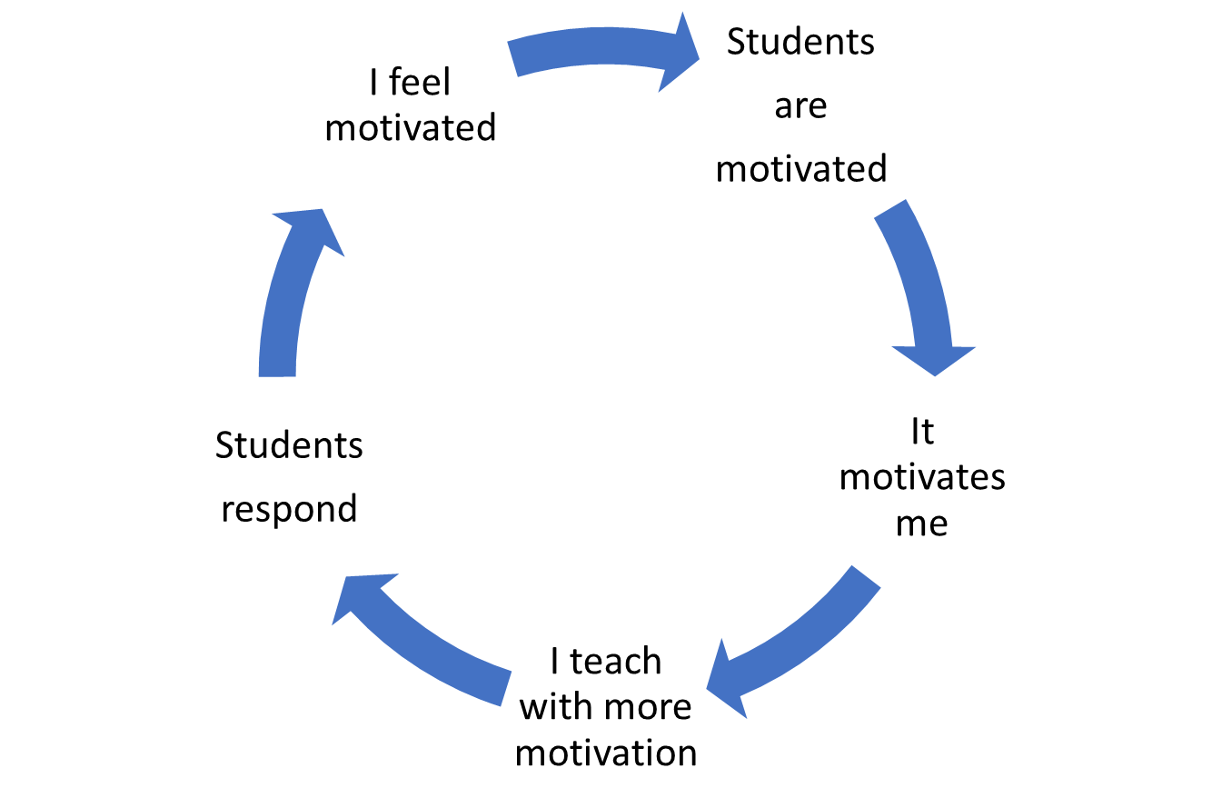

Slide 19
How my students are motivated to learn in 2021
They need to use their technology to get information.
If they do this they can engage with the topic.
They want to find out up to date information on this topic.
They want to make a connection between this topic and their learning.
They want to research themselves rather than be led passively by the teacher.

Slide 20
Mark Prensky originally coined the term ‘Digital Natives & Digital Immigrants.
To what extent do you agree with his other ideas below?
“We live in a screen age, and to say to a kid, ‘I’d love for you to look at a book but I hate it when you look at the screen’ is just bizarre. It reflects our own prejudices and comfort zone. It’s nothing but fear of change, of being left out.”
“Today’s students are no longer the people our educational system was designed to teach.”
“Let’s admit the real reason that we ban cell phones is that, given the opportunity to use them, students would vote with their attention, just as adults would ‘vote with their feet’ by leaving the room when a presentation is not compelling.”

